Slide 1


Slide 2
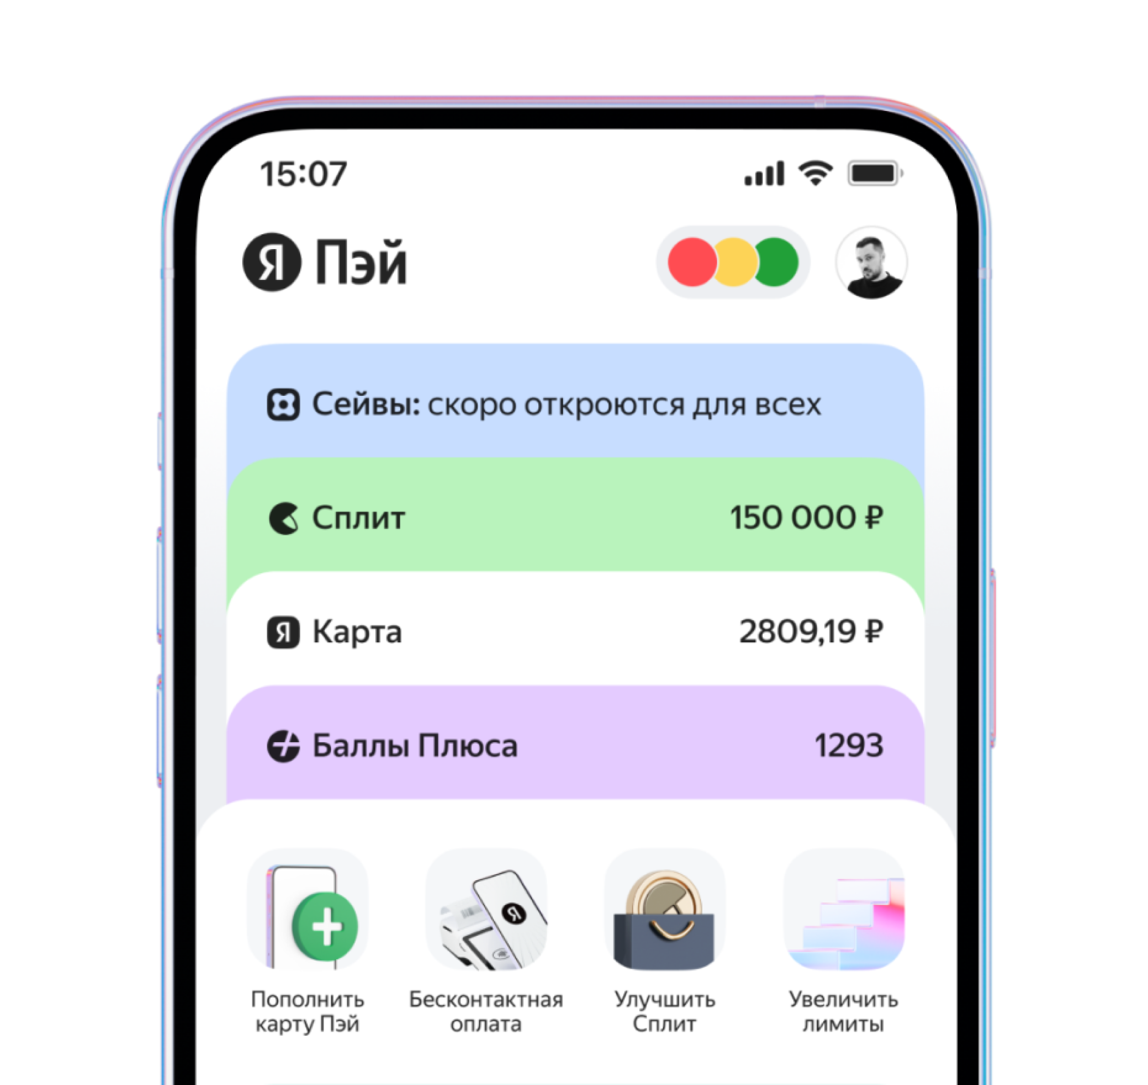
Table of Contents
Company history
Purpose of the bank
The strategy of bank
Service and products
Structure and network
Advertising
Sponsorship
Career opportunities
Conclusion

Slide 3

Company history
JSC "Yandex Bank" (formerly JSC CB Acropolis) is a small Moscow bank in terms of assets, acquired by Yandex in the summer of 2021. The main activity is the placement of free liquidity on the interbank market and on deposits with the Central Bank. The basis of the bank's liabilities is equity.

Slide 4

Purpose of the bank
Yandex Bank is the corporation's pocket (captive) bank and, according to Kommersant, seeks to monetize the large flow of customers who search for goods on the Yandex.Market platform.

Slide 5
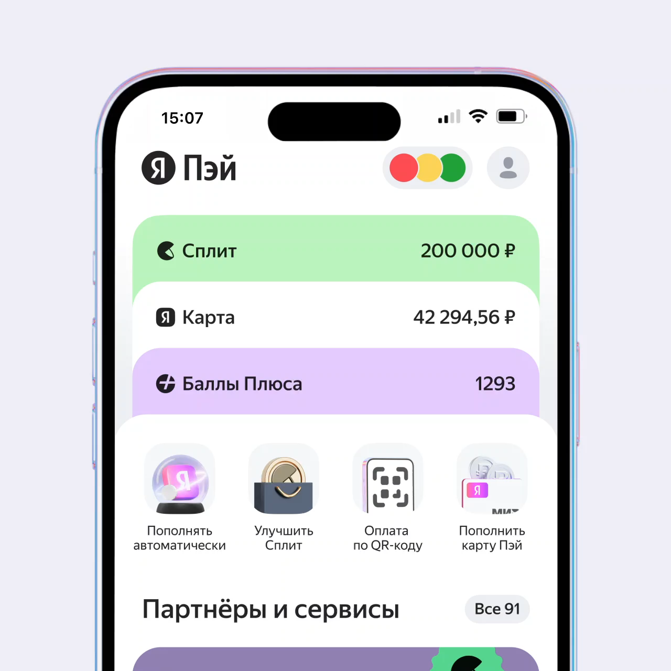
The strategy of the bank
The Bank is a universal financial institution providing a full range of banking services. Yandex Bank provides services to corporate and retail customers.

Slide 6

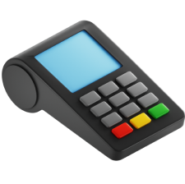

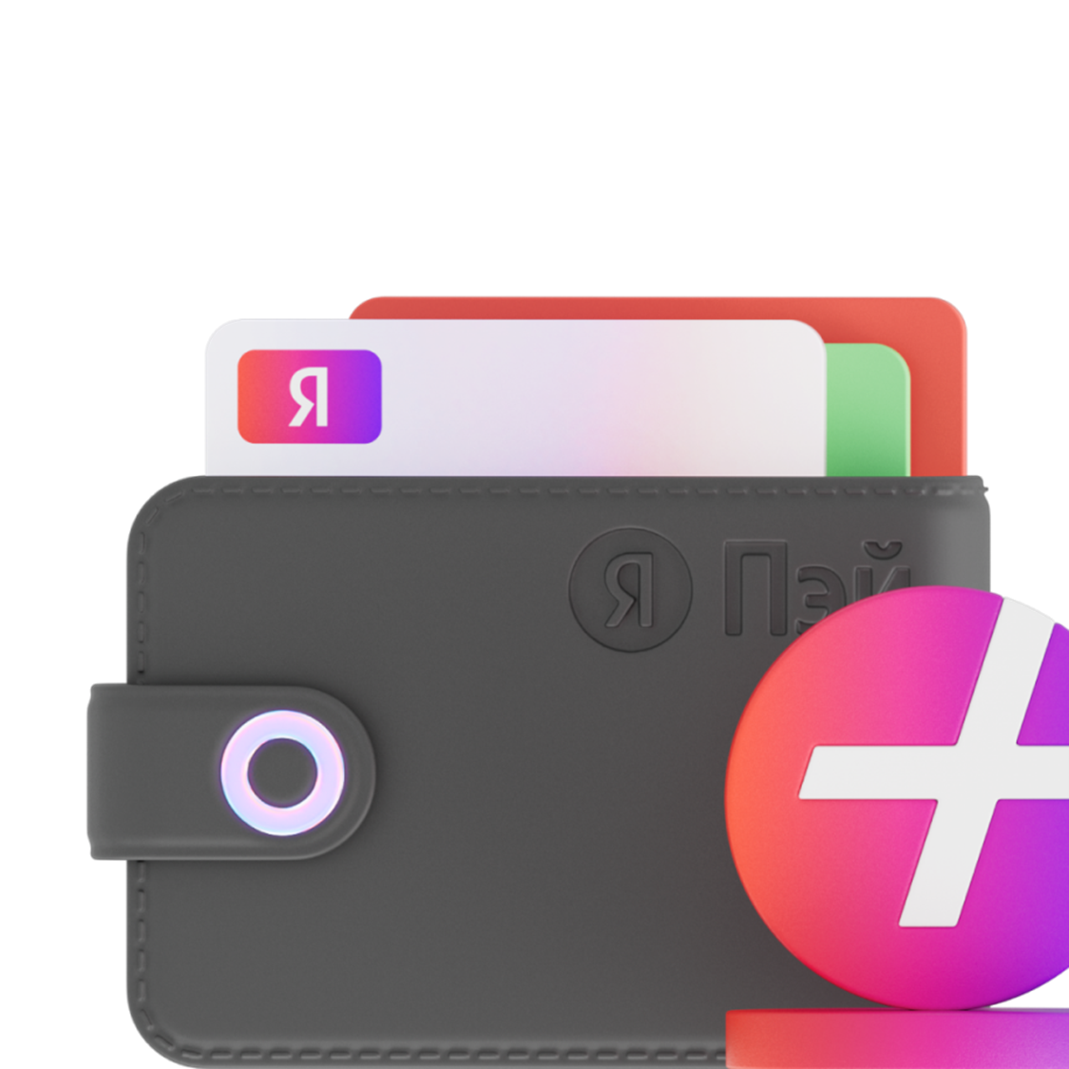






Services and products
MIR Pay
Profit up to 10%
Deposit from Yandex
15% with Plus points
Virtual MIR card for online and offline payments
Discounts, cashback points and great deals at thousands of stores
The rate up to 15% per annum
In Yandex services and partner stores
60 days sub to Yandex Plus
Absolutely free
Movies, music and cashback points Plus. Free for those who haven't subscribed yet
We do not charge commission for service, replenishments and transfers.

Slide 7
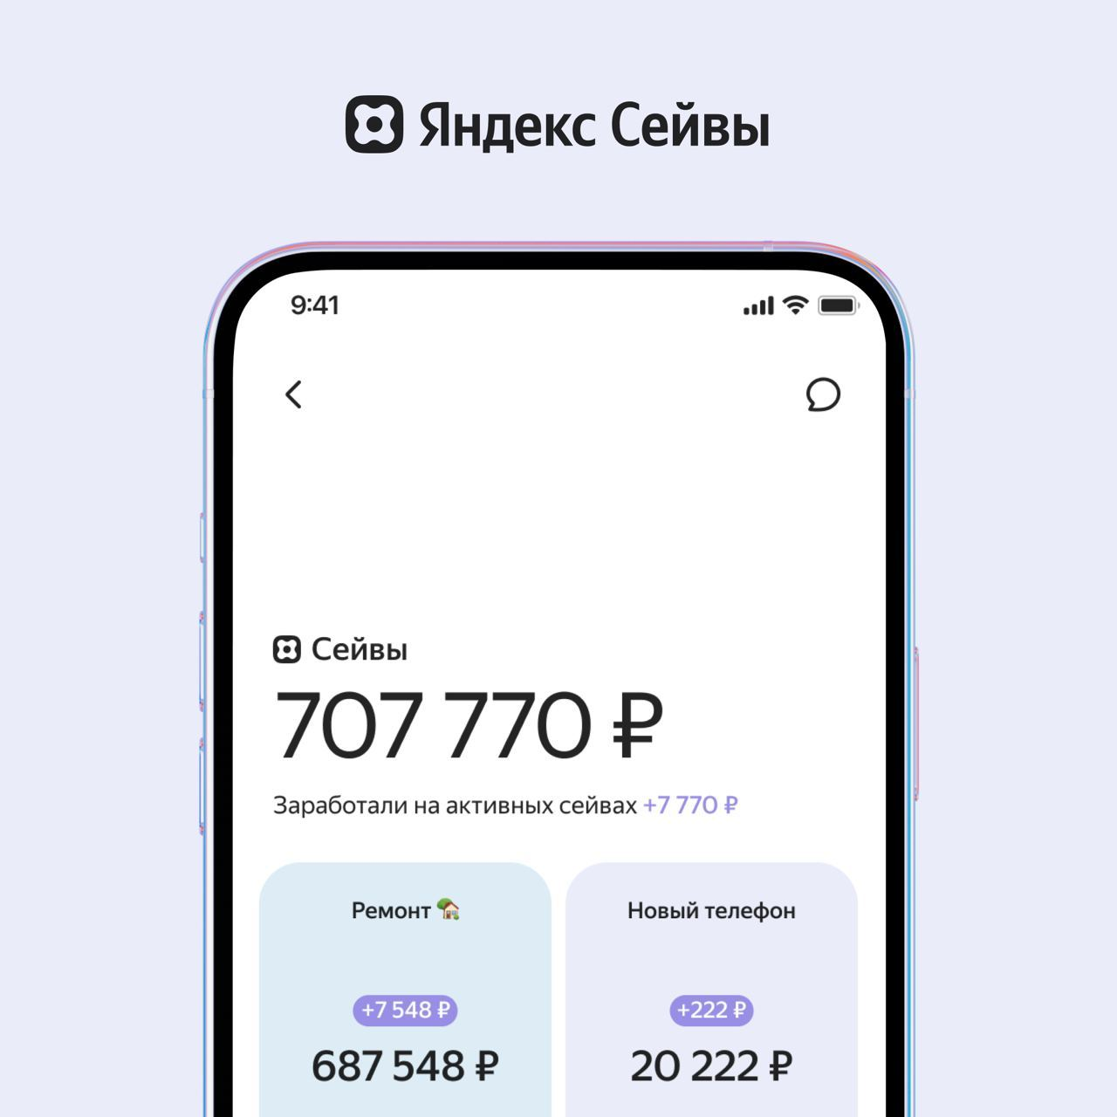
Structure and network
The bank's head office is located in Moscow at 82 Sadovnicheskaya str., building 2, Moscow, 115035.
All customer service is fully online.

Slide 8







Advertising

Slide 9
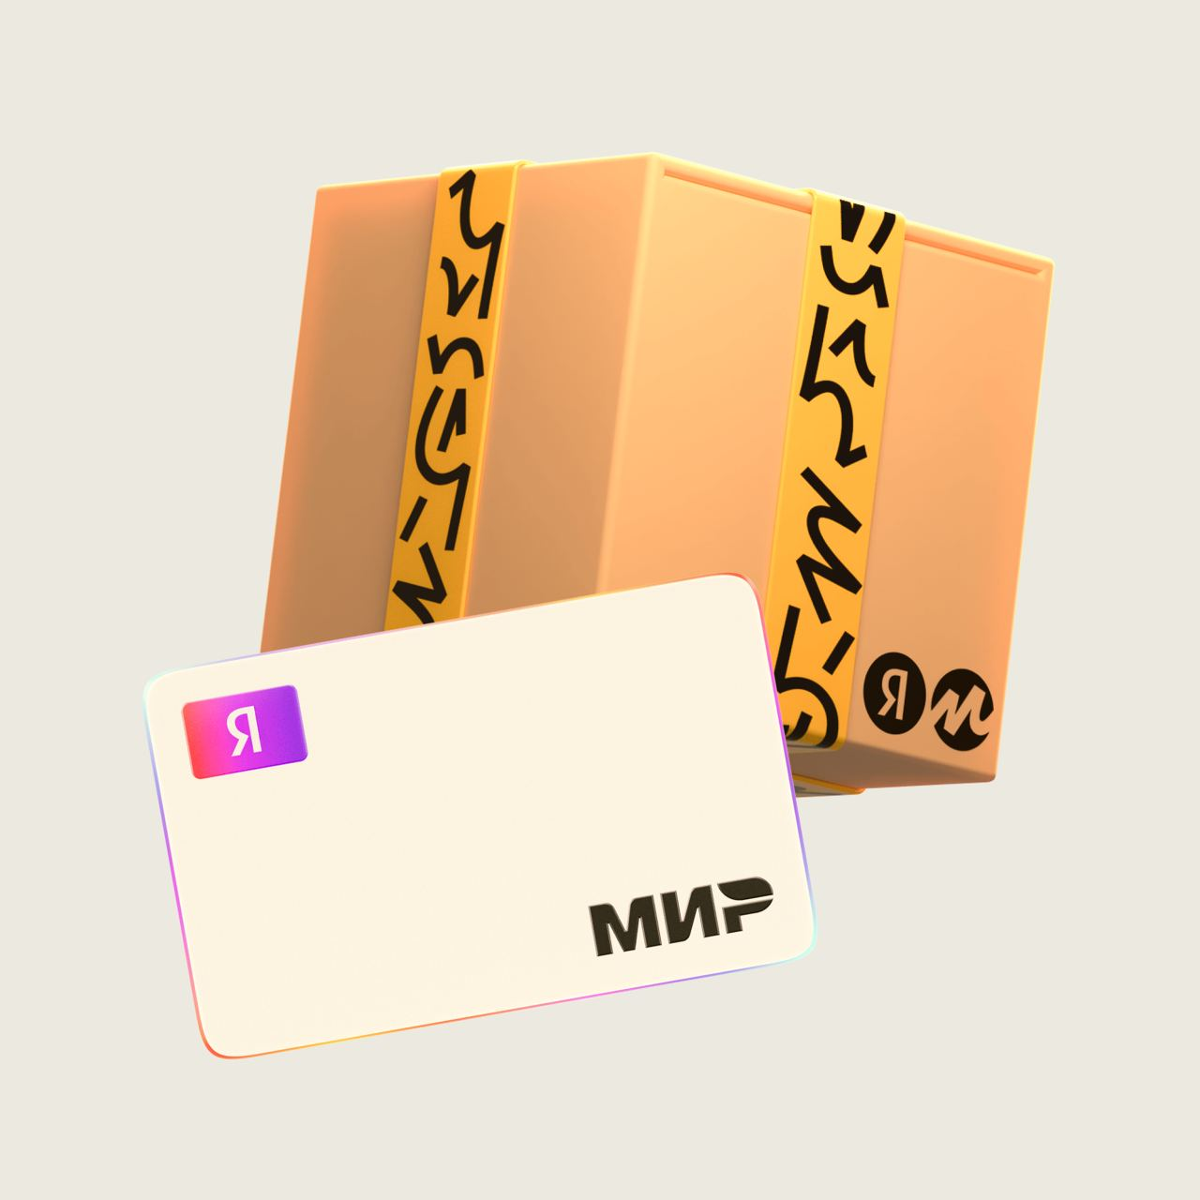
Sponsorship
Judging by the statements of Yandex officials, the bank is still performing service functions, and its development may take a lot of effort.

Slide 10

Career opportunities
The Jobs in Yandex website contains current vacancies in the parent service of the IT company Fintech Services.

Slide 11
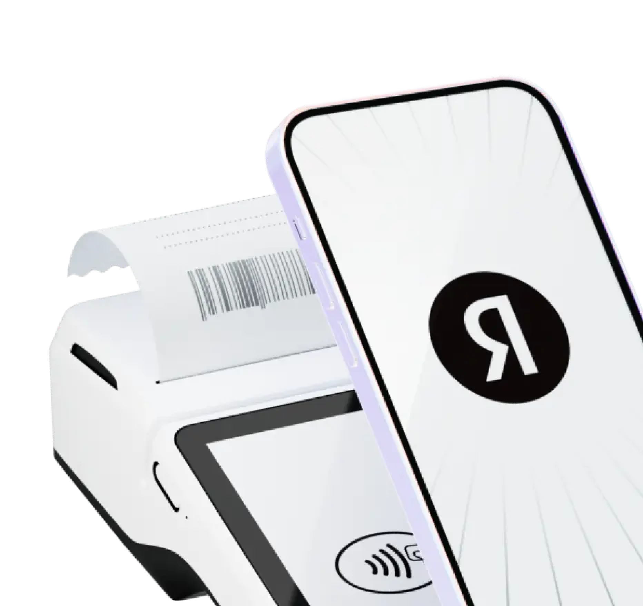

Conclusion
Thus we have reviewed Yandex Bank, its structure, products and services, career opportunities and promotional offers. We also got to know more about the bank's strategy, as well as its features and advantages.
Thanks for you attention!

